Slide 1
Robot Soccer Design
Team /-!#

Slide 2
Overview
Customer Needs
System Architecture
Current Progress
Concept Generation
Next Steps

Slide 3
Overview
Customer Needs
System Architecture
Current Progress
Concept Generation
Next Steps

Slide 4
Customer Needs
Main categories
Be entertaining
Follow the rules
Robots are fully functional
Outperform other teams
These are described in more detail in our Functional Specification Document
https://docs.google.com/document/d/1F_SkeqI-fIXzInFZ_aXNSFDPQGy5avVW_BLnClinqjk/edit?usp=sharing

Slide 5
Overview
Customer Needs
System Architecture
Current Progress
Concept Generation
Next Steps

Slide 6
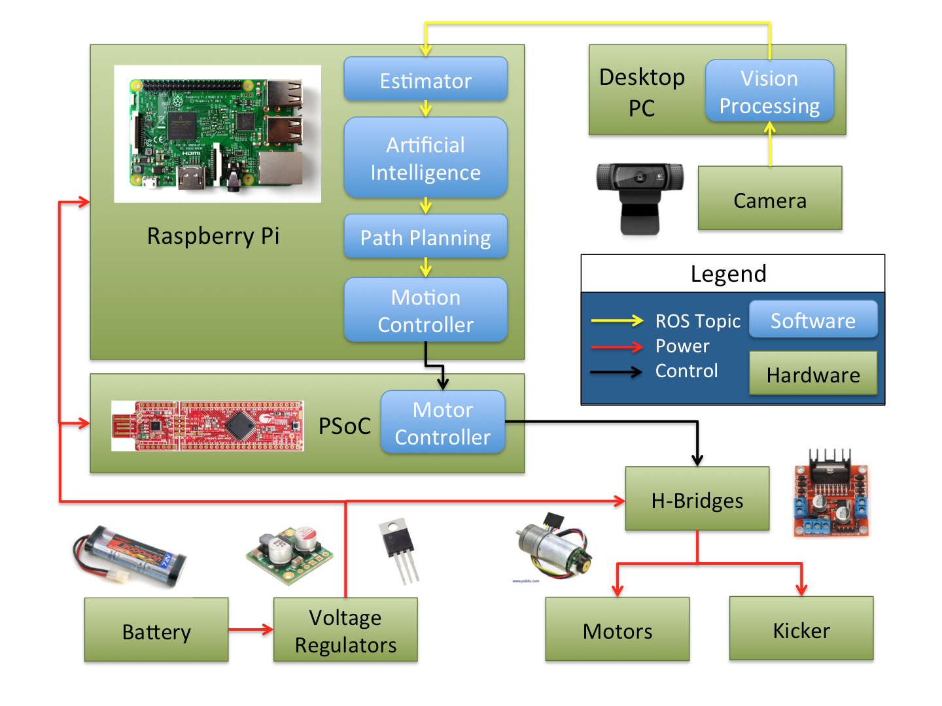
System
Architecture
Notes:
Hi ben

Slide 7
Overview
Customer Needs
System Architecture
Current Progress
Concept Generation
Next Steps

Slide 8
Current Progress
Software
We have a fully working system in software that can do basic defense and offense skills.
We have estimator, AI, path planning, and controller nodes for each robot as the basis of our software architecture.
Hardware
We have a general understanding of layout and design for our robots.
We have built our first prototype.

Slide 9
Overview
Customer Needs
System Architecture
Current Progress
Concept Generation
Next Steps

Slide 10
Concept Generation
Kicker:
Multiple kickers (left and right)
Kickers on multiple sides of robot
Kickers that can kick into the air
Keep the ball in place
Spin on the ball
Entertainment:
Sound effects
Victory dance
LEDs/lights
Decoration
Effective strategies
Mocking strategies
Two-robot play:
Dynamic coordinated roles (vs. static/dynamic independent roles)
Redundant AI

Slide 11
Concept Generation
Roles for Two-Robot Play |  | Concepts
 |  | Static Independent |  | Dynamic Independent |  | Static Coordinated |  | Dynamic Coordinated
Criteria | Weight | Rating | Weight | Rating | Weight | Rating | Weight | Rating | Weight
Play Effectiveness | 40 | 5 | 200 | 7 | 280 | 7 | 280 | 9 | 360
Resistance to malfunction | 10 | 5 | 50 | 7 | 70 | 3 | 30 | 4 | 40
Implementation Simplicity | 25 | 5 | 125 | 3 | 75 | 4 | 100 | 3 | 75
Computational Overhead | 25 | 5 | 125 | 4 | 100 | 6 | 150 | 4 | 100
Totals | 100 |  | 500 |  | 525 |  | 560 |  | 575

Slide 12
Concept Generation
Kicker |  | Concepts
 |  | Basic Solenoid Design |  | Kickers on 3 sides |  | Vertical Kicking |  | Double Kickers (left and right) |  | Putting spin on the ball
Criteria | Weight | Rating | Weight | Rating | Weight | Rating | Weight | Rating | Weight | Rating | Weight
Simplicity (Build & use) | 40 | 5 | 200 | 5 | 200 | 2 | 80 | 3 | 120 | 4 | 160
Effectiveness (Shoot/Pass) | 35 | 5 | 175 | 6 | 210 | 8 | 280 | 7 | 245 | 8 | 280
Cost | 25 | 5 | 125 | 2 | 50 | 4 | 100 | 3 | 75 | 4 | 100
Totals | 100 |  | 500 |  | 460 |  | 460 |  | 440 |  | 540

Slide 13
Overview
Customer Needs
System Architecture
Current Progress
Concept Generation
Next Steps

Slide 14
Next Steps
Software
Get a working vision node
Integrate with hardware
Continue to develop effective AI strategies
Hardware
Prepare for skills competition
Implement motion PID control
Get simple movements working well
Refine robot design - make it more robust and durable

Slide 15
Questions?

